Slide 1
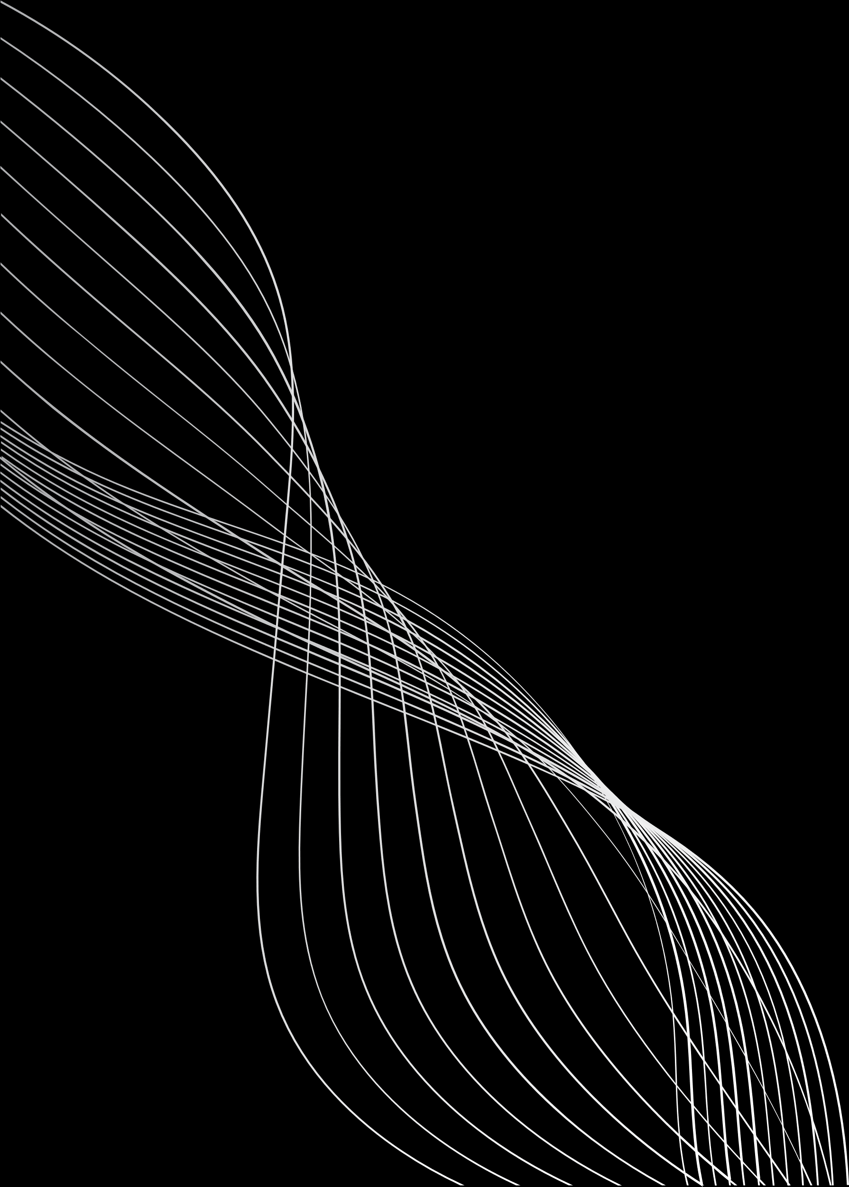


A CLOUD-FOG BASED ARCHITECTURE FOR IOT APPLICATIONS DEDICATED TO HEALTHCARE
authors: Randa M.Abdelmoneem, Abderrahim Benslimane† , Eman Shaaban , Sherin Abdelhamid and Salma Ghoneim(ICCC)
journel: International Carpathian Control Conference (ICCC)

Slide 2
MOTIVATION
The increasing adoption of IoT in healthcare, including ICU monitors, wearable devices, and remote patient monitoring systems, has revolutionized patient care by enabling real-time data collection and analysis. However, many of these healthcare scenarios involve critical conditions that demand ultra-low latency responses to avoid life-threatening delays. Relying solely on cloud-based systems can be problematic, as they often introduce significant latency due to long transmission paths and are vulnerable to network congestion and overload. This makes them unsuitable for time-sensitive applications where every second counts.

Slide 3

PROBLEM STATEMENT
Current cloud-based healthcare systems face high latency and energy inefficiency due to continuous data transmission.
A Cloud-Fog hybrid model with dynamic task allocation is needed to enable real-time processing of critical patient data.

Slide 4
WHY THIS IS AN EDGE PROBLEM ?
This healthcare IoT system is an edge computing problem because it involves real-time processing of critical medical data generated by sensors close to patients. Tasks like emergency detection, fall alerts, or ECG monitoring require instant response, which cannot be achieved if all data is sent to the cloud.
Edge (fog) computing allows local devices (like gateways or fog nodes) to analyze and act on data immediately, ensuring low latency, context awareness, and mobility support. The cloud is only used for non-urgent tasks or long-term storage. Therefore, the need for fast, distributed, and intelligent decision-making at the source makes this system a clear edge computing problem.

Slide 5
PLAN OF IMPLEMENTATION
Architecture Layers:
1) IoT (Things) – Wearables, bio and activity sensors
2) Sink Layer – Mobile devices and smartwatches for data forwarding
3) Fog Layer – Local computing with modules for task scheduling, emergency detection, and context management
4) Cloud Layer – For long-term storage and non-urgent processing

Slide 6
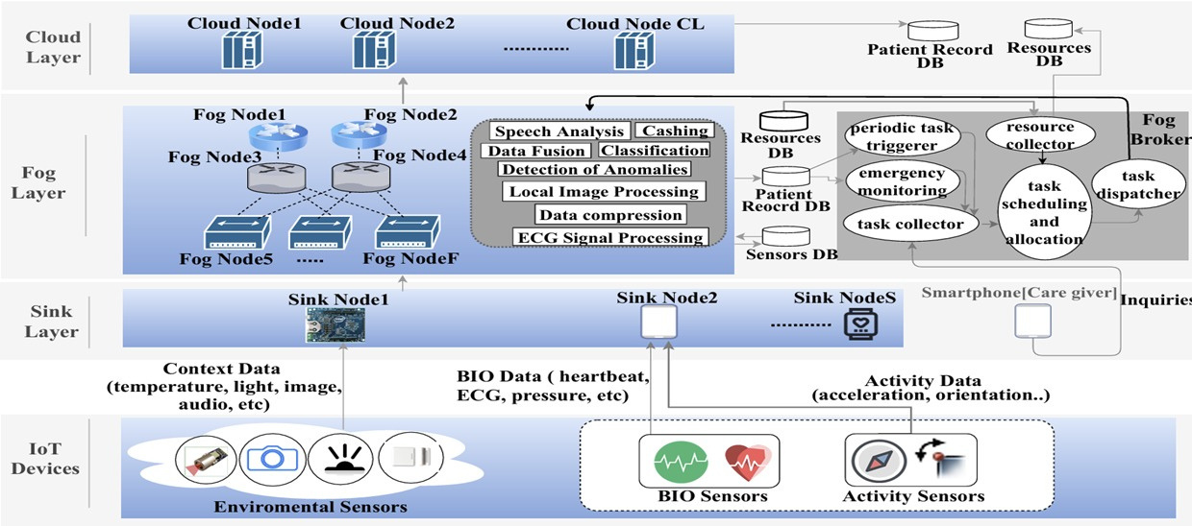
ARCHITECTURE & DATA FLOW

Slide 7
State of art | Proposed System / Architecture | Features | Limitations
Health-CPS | Cloud-based smart healthcare system | Supports statistical monitoring, prediction | Cloud-only; limited real-time support
Mobile Device + Server | Monitors chronic disease patients | Simple and portable | Limited to mobile-cloud communication
Bio-potential Remote Monitoring | ECG-based remote health monitoring | Uses IoT body sensing, gateways, cloud | Processing handled in cloud only
Ubiquitous Healthcare System (UHS) | For elderly care | Home care, emergency assistance, remote medical services | Limited flexibility
ECG Cloud Monitoring | Monitors ECG and updates medication | Provides feedback through mobile | High dependency on cloud
Fog-based E-health | Detects patient falls, gas leaks | Implemented in real environment | Limited to two static scenarios
Fog-assisted Fall Detection | Fall detection via mobile fog device + cloud | Mobile device acts as fog node | Basic local processing only
Fog-based Speech Processing | For Parkinson’s patients | Fog used for speech analysis | Specific to speech data
Fog-to-Cloud (F2C) for COPD | COPD monitoring using F2C | Real-time processing concept introduced | No details on node allocation or handling
Fog Data Enhancement | Enhances big data for telehealth | Uses fog for pre-processing | Task offloading not detailed

Slide 8
WHY FOG COMPUTING ?
The Edge Solution refers to a computing strategy where data is processed, analyzed, and acted upon directly at or near the source of data generation — such as IoT devices, sensors, or nearby local gateways — rather than sending all the data to a centralized cloud server for processing.
BENEFITS:
1. Ultra-low latency 6. Lower cloud costs
2. Real-time decision making 7. Context-aware processing
3. Reduced bandwidth usage 8. Improved quality of healthcare services
4. Enhanced data privacy and security 9. Scalability
5. Cloud independence 10. Seamless integration with fog and cloud

Slide 9
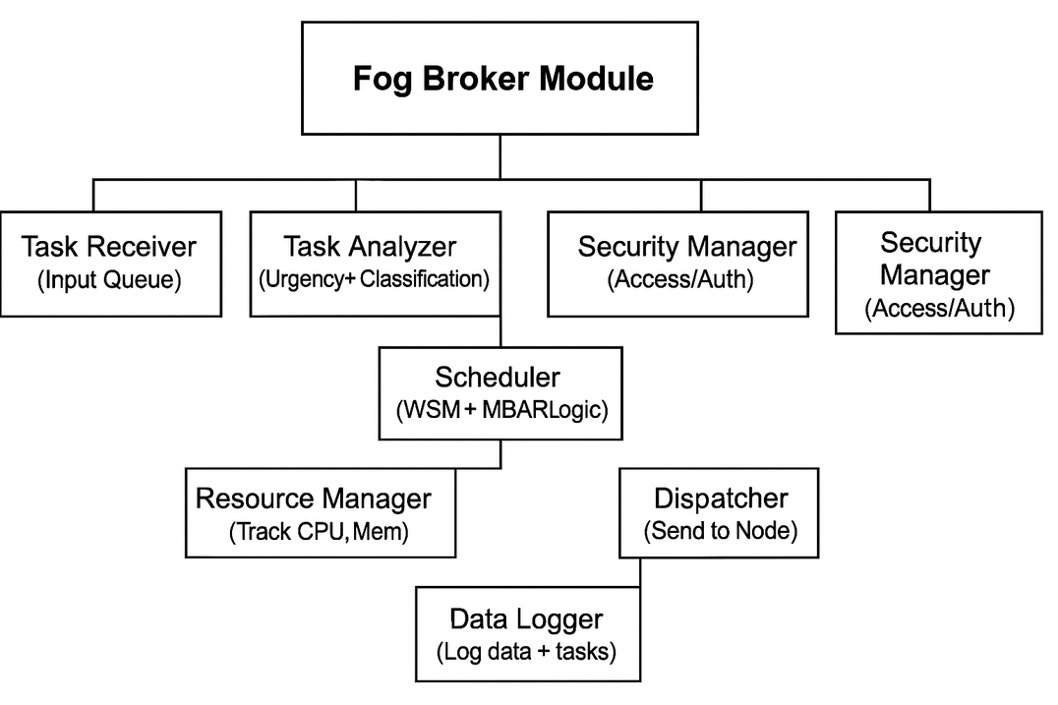
FOG BROKER MODULE :
A Fog Broker is the central controller at the fog layer responsible for managing tasks coming from IoT devices.
It ensures that data is processed intelligently, quickly, and efficiently — especially critical in healthcare scenarios.
Explanation of Flow:
Task Receiver – Gets incoming healthcare data from sink layer (e.g., heart rate, SpO₂).
Task Analyzer – Flags urgency (e.g., SpO₂ < 90%) using rules or ML.
Security Manager – Handles access, authentication, encryption.
Scheduler – Applies WSM for priority + MBAR for node allocation.
Resource Manager – Tracks available fog resources to prevent overload.
Dispatcher – Sends tasks to fog/cloud nodes accordingly.
Data Logger – Stores task outcomes for analysis, debugging, or AI training.

Slide 10
TASK SCHEDULING & ALLOCATION
In healthcare IoT systems, tasks such as patient vital monitoring, emergency alerts, or routine data logging must be scheduled and processed based on their urgency, resource demand, and network condition.
Since not all tasks are equally critical, an intelligent system must:
Evaluate tasks based on urgency and requirements
Prioritize time-sensitive or life-threatening tasks (e.g., abnormal ECG)
Assign them to the best-suited node (fog or cloud)
Two key algorithms are used in this architecture:
Weighted Sum Method (WSM) for prioritization
Modified Best Available Resource (MBAR) for allocation

Slide 11
WEIGHTED SUM METHOD (WSM) – TASK PRIORITIZATION
The WSM algorithm is a Multi-Criteria Decision Making (MCDM) technique used to assign a priority score to each incoming task based on weighted parameters.
Priority Score = w1 × Latency + w2 × Energy + w3 × Urgency
Where:
Latency (w1): How delay-sensitive the task is
Energy (w2): How much energy it would cost to process
Urgency (w3): How critical the task is for patient care
Key Points:
Weights can be tuned based on hospital policies or task types
High-score tasks are processed first (preferably in fog layer)
Low-score tasks can be delayed or offloaded to cloud
Example:
A critical oxygen drop alert may get a high urgency score → processed in Fog
Regular temperature logging may get low urgency → processed in Cloud

Slide 12
MODIFIED BAR (MBAR) – TASK ALLOCATION
The MBAR algorithm (Modified Best Available Resource) ensures tasks are assigned to nodes that can handle them quickly and efficiently.
Working Steps:
Check the priority score from WSM
Find the closest fog node with enough available resources
🔍 Why MBAR?
Prevents overloading any single fog node
Ensures that urgent tasks don’t wait
⚙️ Key Features:
Real-time dynamic scheduling
Supports fault tolerance
Summary:
Step Purpose Algorithm
1 Prioritize incoming tasks WSM
2 Allocate to best-fit node MBAR

Slide 13
SIMULATION PLAN (IFOGSIM)
Objective: To simulate and evaluate the performance of our proposed Cloud-Fog architecture for healthcare tasks.
Simulator: iFogSim (Java-based IoT and Fog computing simulator).
Setup: Model 300 healthcare tasks with varying priority (ECG, fall detection, vitals monitoring).
Architecture: Simulated layers for IoT devices, Fog nodes, and Cloud nodes.
Algorithms used:
WSM (Weighted Sum Method) for task ranking.
MBAR (Modified Balance-Reduced) for task allocation.
Scenarios: Compare task allocation strategies (Random vs WSM vs MaxResponse).
Goal: Observe system behavior under critical and non-critical conditions.

Slide 14
EVALUATION METRICS
How we measure the system’s performance:
Makespan
Total time to complete all tasks.
Miss Ratio
% of tasks that missed their deadline (especially critical ones).
Average Delay
How late the missed tasks were, on average.
Cost per Execution
Total cost incurred due to use of cloud resources.
Resource Utilization
How efficiently fog and cloud nodes are used under load.

Slide 15
CONCLUSION & FUTURE WORK
Key Takeaways:
The Cloud-Fog system significantly reduces latency for time-sensitive healthcare tasks.
Task prioritization using WSM and smart allocation with MBAR improves real-time performance.
Simulations show reduced miss ratio and better resource usage compared to random allocation.
Future Work:
Implement a working prototype using STM32/Raspberry Pi and actual sensor inputs.
Integrate with real-time alert systems in healthcare environments.
Test on live network with dynamic sensor data.

Slide 16
TEAM MEMBER CONTRIBUTIONS
Nikshith: Introduction & Problem Understanding
Responsibilities:
•Explain cloud-fog computing in the context of IoT healthcare
•Describe the core problem (high latency, cost, centralized processing limitations)
•Present the problem statement and system limitations
Hemanth: Architecture & Edge Solution
Responsibilities:
•Describe the proposed 4-layer architecture:
•Explain how fog nodes handle task distribution
•Define the Edge Solution and its role in the system
•Cover slide(s): Plan of Implementation, What is the Edge Solution?
Akhil: Algorithms & Task Allocation
Responsibilities:
•Explain task classification: critical vs non-critical
•Describe the task allocation strategy:
•Ranking with WSM (Weighted Sum Method)
•Scheduling with Modified BAR (MBAR) algorithm
•Include formulas and processing logic briefly
Tejeswar: Benefits, Summary, and Conclusion
Responsibilities:
•Summarize the benefits of the edge/fog approach:
•Ultra-low latency, cloud independence, scalability, etc.
•Highlight how this architecture improves healthcare service quality
•Conclude with key outcomes and future scope

Slide 17
Any Doubts
?

Slide 18
THANK YOU

